Slide 1
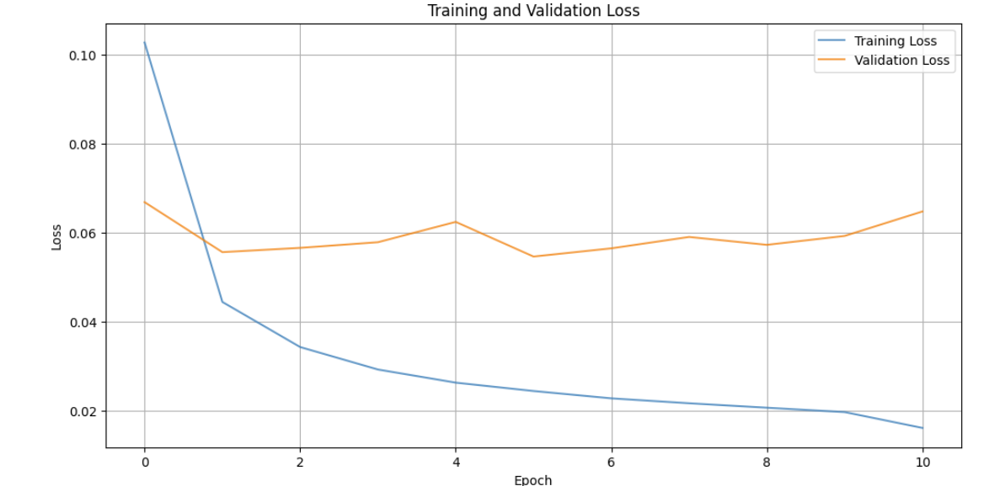
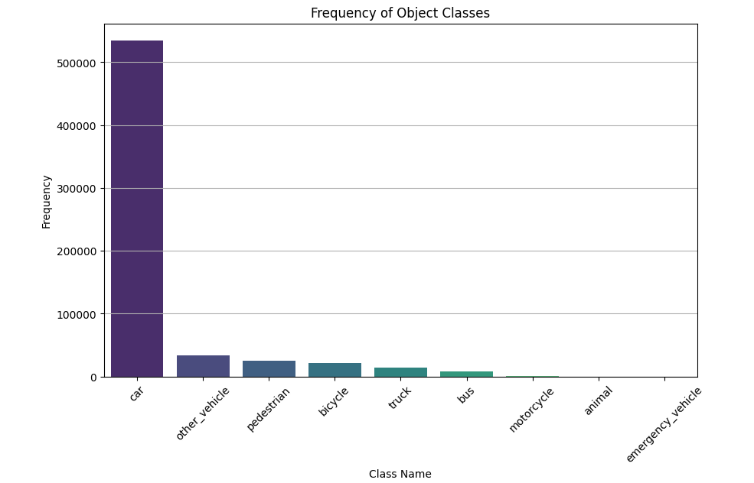
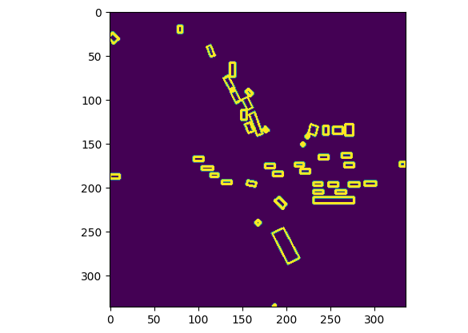
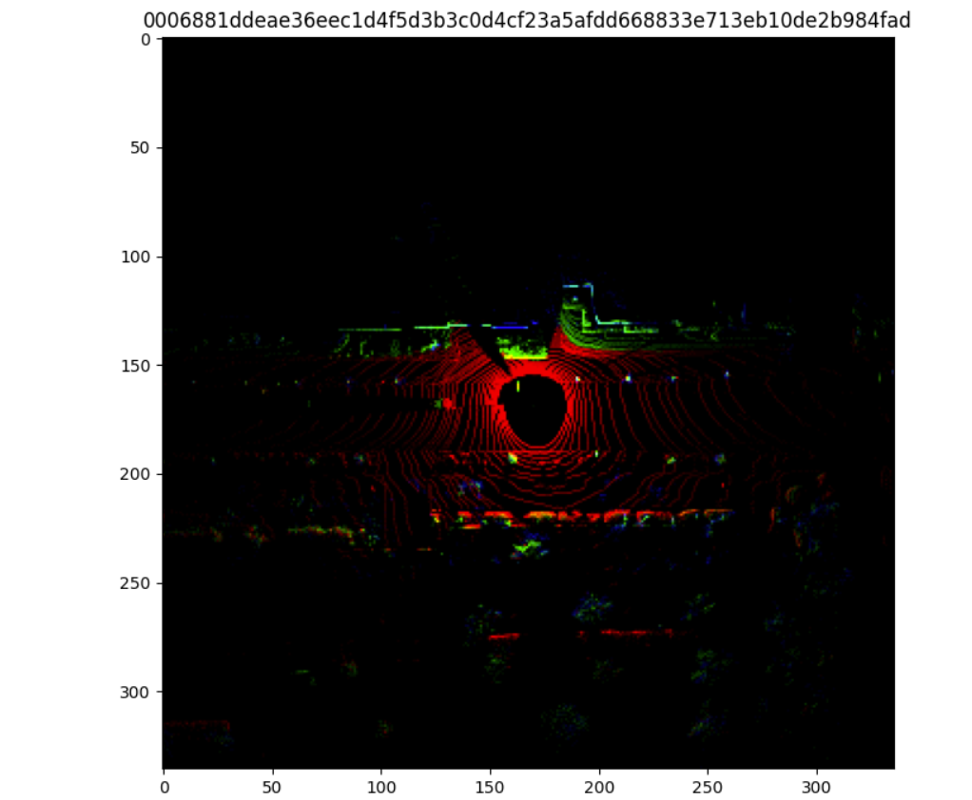
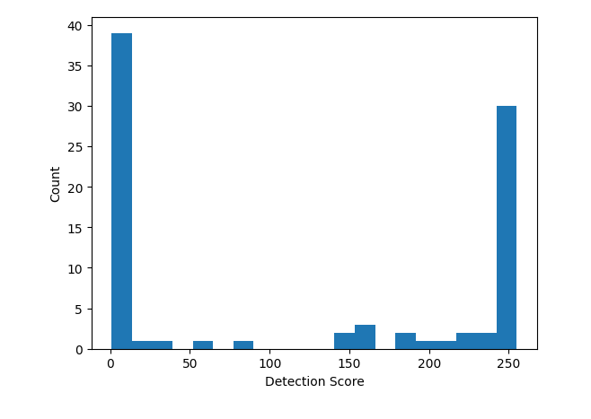
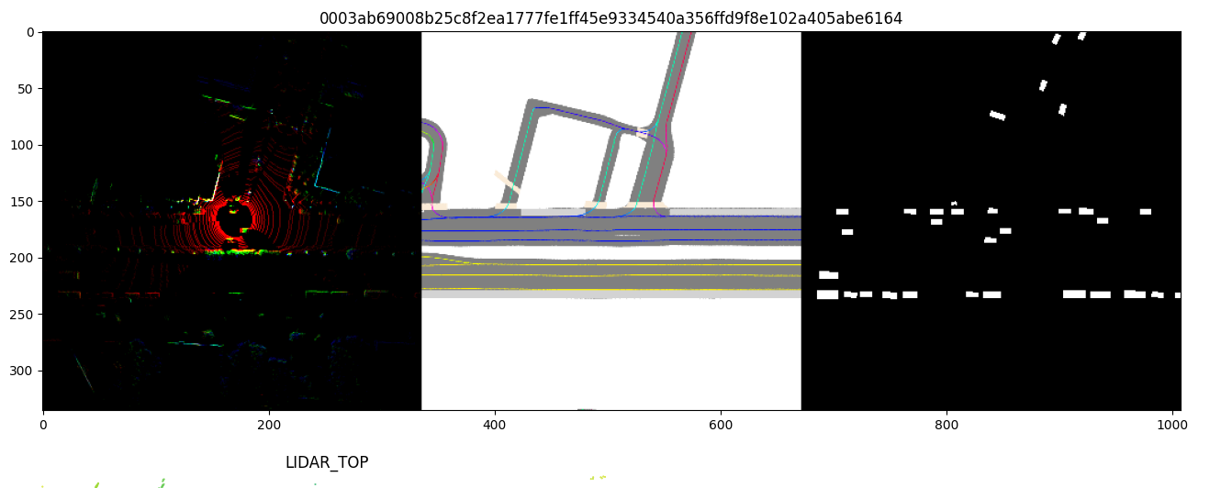
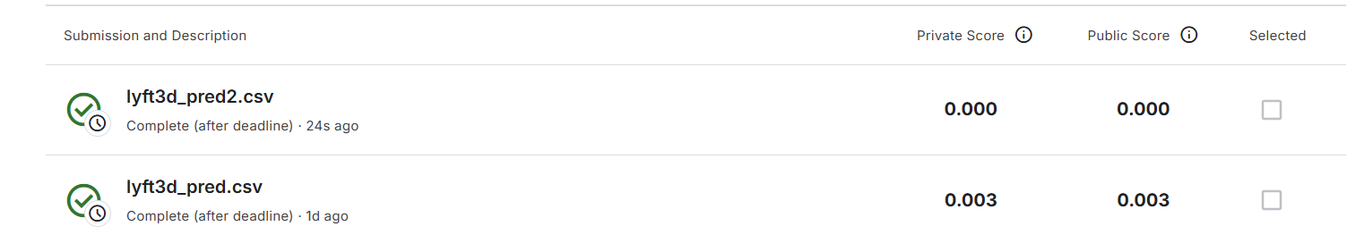

Lyft 3D Object Detection for Autonomous Vehicles
Ryan O’Hara Department of Applied Analytics, Boston College
Abstract
The goal of this project is to develop an object detection model for self-autonomous vehicles using LiDAR Point Cloud Data sourced from the Lyft 3D Object Detection for Autonomous Vehicles Dataset as part of the “Lyft 3D Object Detection for Autonomous Vehicles” Kaggle competition.
Two UNET models are constructed using the same base architecture with slight adjustments within the loss functions and dropout utilization. Bird’s Eye View images are generated for each sample ID in both the train and test sets and are the main input to the model.
Both UNET models underperformed against expectations but leave a solid foundation and data modeling pipeline for future research and model refinement using UNET architecture.
This project uncovers the power of UNET models in segmentation problems. This type of problem will become more and more relevant as automation continues to be a goal of society. Some use cases include self autonomous vehicles, medical diagnosing, robot vision, and security.
Methods
Data PreProccessing
The dataset provided for this competition included images, LiDAR point cloud data, and maps organized through a number of interlocking tables and formats. JSON files contain tables with identifying tokens that are used to join files/tables across the dataset. Sample_data.json maps all images and LiDAR files for a specific sample to a unique sample ID. Train.csv contains the ground truth of 3D bounding boxes including center coordinates (x, y, and z), width, length, height, yaw (angle/orientation of the bounding box), and class type.
The Lyft Dataset sdk package was downloaded from the competition creators and contains many functions for processing and transforming the data into workable inputs for UNET models.
The base UNET model provided by Lyft in the nuscenes-devkit GitHub Repository served as inspiration. The UNET model input consisted of Bird’s Eye View (BEV) images: 2D gridded images generated from processed LiDAR point clouds containing 3 RGB layers representing height and intensity. The training model took in addition inputs; a semantic map (encodes features such as road layouts) and target maps (ground truth masks used in model training).
Model Building
Two UNET models were trained and tested:
Core architecture for both models:
6 Input Channels: BEV image (3 input channels), semantic map, target map, empty input
4 convolutional layers
Width Factor of 5 (first layer has 2⁵ filters (32) and doubles each layer)
Upsampling to reconstruct feature maps
Early Stopping after 5 epochs without validation improvement
UNET Model1:
Optimizer: ADAM (learning rate of .0001)
Loss Function: Cross Entropy Loss
UNET Model2:
Loss: Dice and Cross Entropy combined loss function
Dice loss to address the class imbalance and often used for segmentation models
Test Data
Testing data was prepared using testdataset-try2 python script. Blank semantic and target maps were produced for each sample token. These maps were initially ignored but included to satisfy the 6-channel input requirement for the model. The BEV inputs were generated in the same way as the training and validation data.
Predictions are run in the predictions.py script. 2D bounding boxes are predicted and transformed back to 3D format. Class predictions are also performed. All bounding box and class predictions are placed in a submission csv following the competition’s requirements.
Results
Performance Metrics
UNET Model1 finished training and validation with a mean validation loss score of .05466 suggesting the model is performing well on the validation set. When testing the model a mAP (mean average precision) score of .003 was achieved suggesting the model was not performing well on unseen test data.
UNET Model2 finished training and validation with a mean validation loss score of .1 suggesting a worse performance than the first model. This hypothesis held true as a mAP score of .0000 was achieved suggesting the model was performing very poorly on the test set.
Both models took about 1.5 hours to train (similar architectures). Testing predictions took about 10 minutes to produce and another hour to transform into 3D bounding boxes. Due to limited resources, only a few models were able to be developed and tested.
Discussion
UNET Models
The UNET models performed underwhelmingly on the testing data. UNET Model1 achieved a mAP score of .003 suggesting poor performance but some accuracy in the inference. The UNET Model2 achieved a mAP score of .000, suggesting the model was not accurate at all. This was surprising, as an updated loss function utilizing Dice Loss (beneficial for segmentation problems) was implemented as well as neuron dropout in the convolutional layers.
The base architecture, processed BEV images for both the training/validation and test sets, and correct submission format pipeline gives a starting point for further model refinement in the future.
Limitations
Limitations of the challenge included limited resources (30 hours of GPUs per week), long run times (1-3 hours to run a full model: creating train/val/test data, model training, and inference), and the vast amount of data supplied (over 100GBs).
A limited domain knowledge on LiDAR point cloud data was also a limitation.
Recommendations
In the future, I recommend training a UNET model with less than 6 input channels. The model implemented in for this project took two inputs for training that were not available in the testing data (semantic and mask maps). We should explore training models with only BEV images as inputs.
A YOLOv5 model was attempted using the BEV images but was not successful. This is another area of future research that should be explored. One challenge of YOLO is it is optimized for 2D images, and some adjustments may need to be implemented to successfully predict on 3D datasets.
Other models can be explored that use picture data vs LiDAR data to see if results improve.
Graph tracking UNET Model1 training and validation loss across 10 epochs (training stopped due to early stopper)
Frequency table of Object Classes: There is a major class imbalance in the data, with a vast majority of detections belonging to the ‘car’ class.
An example of a predicted bounding box mask map generated by the UNET1 model. Bounding boxes are in 2D.
Conclusion
This project serves as a base model/starting point for future research on self-autonomous vehicles detection algorithms. UNET models have proven successful in the past for many segmentation problems such as medical diagnoses using imaging and should be continued to be explored. Other novel models such as YOLO should be explored in the future. Although the modeling is not sound enough to deploy self autonomous vehicles yet; the technology is promising and can provide a safer day to day life for millions of people across the world. Refined image/object detection models can be used for other applications as well, such as labor robots (used to perform dangerous tasks in the field).
Introduction & Significance
Visual input is one of the most powerful sensory modalities for humans, and training computers to identify patterns in images opens a wide range of powerful applications.“Computer Vision (CV) is a field of artificial intelligence that uses machine learning and neural networks to derive meaningful information from digital images” (IMB). CV models can be leveraged to make both classification decisions, perform object detection, and image segmentation.
Computer Vision has many modern applications. CV models are used in security and law enforcement (facial recognition, license plate identification), language translation (Google Translate allows users to submit photos of foreign documents), self-driving cars, medical diagnosis from MRI images, environmental monitoring, and robotics to name a few. The applications and accuracy of CV models are rapidly increasing by the year.
Problem Overview:
In 2022 alone, 42,514 people died in motor vehicle crashes across the United States while incurring an economic cost of 340 billion dollars. This equates to 12.8 deaths per 100,000 people or 1.3 deaths per 1 million miles driven (iihs.org). On the positive, this number is decreased from 20.6 deaths per 100,000 people in 1975. Events such as criminalizing drinking and driving (1988), requiring seatbelts, stricter driving education, awareness, improvements in car safety, and infrastructure improvements are driving factors behind this decrease. Males between the ages of 20 and 29 carry the highest risk of dying in a motor vehicle accident with a rate of almost 27 per 100,000 people (iihs.org). Speeding was deemed a factor in 29% of motor vehicle crash deaths, 63% of drivers were believed to be distracted in some way (12% attributed to cell phone use) although these numbers are believed to be under reported (iihs.com).
Self-driving car technology is improving year after year, and what once was thought to be a fever dream may soon become reality with organizations like Lyft investing in its development. Self driving technology has the potential to improve the quality of life for billions of people across the world. Americans have an average of a 50 minute commute round trip each day for work (bankrate.com). Self driving vehicles could free this time up for tasks such as emails, calls, or relaxing. In addition, machines have been proven to be great and efficient decision makers that can process information much faster than humans. Self driving vehicles could decrease motor vehicle deaths by a significant factor, save individuals and insurance companies billions of dollars each year, reduce toxic environmental waste, and give hard working people an extra hour in their day. AI algorithms will not drink and drive, make emotional decisions, be distracted, fall asleep, etc.
When employing a novel technology like this it is paramount these models are trained and validated very carefully for the safety of all. This project aims to develop a Computer Vision Model to identify objects on the road in real time, enabling the vision aspect of self driving vehicles.
An example of a BEV image input for a specific sample ID. Note three color channels representing height and intensity: red: low height, green: high height, blue: intensity
A detection score frequency table for a testing sample. Confidence scores are on a scale of 0-255. The distribution is bimodal suggesting the model is either very confident or not at all confident on predictions; there is not much middle ground.
References
IBM. “Computer Vision.” Ibm.com, 27 July 2021, www.ibm.com/think/topics/computer-vision.
IIHS. “Fatality Facts 2017: Yearly Snapshot.” IIHS-HLDI Crash Testing and Highway Safety, 2017, www.iihs.org/topics/fatality-statistics/detail/yearly-snapshot.
OpenAI. “ChatGPT.” Openai.com, 2024, openai.com/chatgpt/overview/.
“U-Net Architecture Explained.” GeeksforGeeks, 8 June 2023, www.geeksforgeeks.org/u-net-architecture-explained/.
“UNET Models - Bing.” Bing, 2022, www.bing.com/search?q=UNET+models&cvid=43528aad9e4348b2b0693d5bba4f99f6&gs_lcrp=EgRlZGdlKgYIABBFGDkyBggAEEUYOTIGCAEQABhAMgYIAhAAGEAyBggDEAAYQDIGCAQQABhAMgYIBRAAGEAyBggGEAAYQDIGCAcQABhAMgYICBAAGEDSAQgxNTM3ajBqNKgCALACAA&FORM=ANAB01&PC=DCTS. Accessed 15 Dec. 2024.
The following python scripts can be found in the competition shared code: https://www.kaggle.com/competitions/3d-object-detection-for-autonomous-vehicles/code :
Understanding the data - Tarun Paparaju,Reference
Model - Guido Zuidhof,
Lyft: EDA, Animations, generating CSVs – xhlulu
Kaggle submission scores. Unet model1 produced better results. Both scores are underwhelming suggesting more refinement is needed.
An example of a full training input for a specific sample ID: BEV image (left), semantic map (middle), and target mask map (right).

Slide 2
Guidelines for a 48”x 36” poster
Presenter name, Associates and Collaborators Department of {Insert Name Here}, College {Insert Name Here}, University {Insert Name Here}
Abstract
Content goes here: Totat ullaborernam harci cus, cuscidendit lat et as eum explit apicaboria am que vendent inullup tatur? Quia voluptat ut prae. Qui blatibu saecture, ut volor as a audae es elenti quis qui tessum faccuptatet odignisim eatur, sincia nusdantent estem haruntiatint idit rem ulpa et exped que provitatatur seque pro idi nos quid quo vent.
Subheader
Ossus volupicabore et iminciae nitati diaeculpa cumquo omnihil et, occulpa venient ab ilibusam volectes vellic tori sitius inciis net voluptatiis auditius dem venimus, ium eatius dolupta
Subheader
Ossus volupicabore et iminciae nitati diaeculpa cumquo omnihil et, occulpa venient ab ilibusam volectes vellic tori sitiusam inciis net voluptatiis auditius dem venimus, ium eatius dolupta tatumquae num eos im fugitis ipienimet estisit, que con nonsequi culluptia as dis consequatem qui aliqui doluptatum est, od quo blab ilias eum exeres delitem qui ipiti omnisquam harchic empere.
Methods
Subheader
Ment etur? Fera vit faccae porporis dusa pratur,
sapelit qui deliquis diasperunt et quame rerest
venisimagnis quid eost adi blabo. Nemo voloria cor
sendaes et esequis soluptati comni seque etus
volorpo remquas aceseri aectiae volorro to quiatis
molupti rerovit, cuptae. Nem. Magnat.
• This is the suggested format for bullets
• Sendaes et esequis soluptati comni seque etus
• Vellic tori sitius inciis net
• Tori sitiusam inciis net voluptatiis auditius dem venimus
• Tori sitiusam inciis net voluptatiis auditi
Uciam que nit vit etusand andam, torae consequam
haruntis et hiciisi nonsectius re sumque con eatatempor
restesto dolut diciis enisti optatus modis aliquia audita int
volene nonsequiae verumet videndu sdandelit aliaediae.
Nem sus.
Results
Subheader
Totat ullaborernam harci cus, cuscidendit lat et as eum explit apicaboria am que vendent inullup tatur? Quia voluptat ut prae. Qui blatibu saecture, ut volor as a audae es elenti quis qui tessum faccuptatet odignisim eatur, sincia nusdantent estem haruntiatint idit rem ulpa et exped que provitatatur seque pro idi nos quid quo vent.
Quia voluptat ut prae. Qui blatibu saecture, ut volor as a audae es elenti quis qui tessum faccuptatet
Suggested format for numbered list:
Auditius
dolupta tatumquae
Auditius
nusdantent
nonsectius re sumque
Uciam que nit vit etusand andam, torae consequam haruntis et hiciisi nonsectius re sumque.
Discussion
Subheader
Content goes here: Ossus volupicabore et iminciae nitati diaeculpa cumquo omnihil et, occulpa venient ab ilibusam volectes vellic tori sitiusam inciis net voluptatiis auditius dem venimus, ium eatius dolupta tatumquae num eos im fugitis ipienimet estisit, que con nonsequi culluptia as dis consequatem qui aliqui doluptatum est, od quo blab ilias eum exeres delitem qui ipiti omnisquam harchic temper.
Ossus volupicabore et iminciae nitati diaeculpa cumquo omnihil et, occulpa venient ab ilibusam volectes vellic tori sitiusam inciis net voluptatiis auditius dem venimus, ium eatius dolupta
Subheader
Ossus volupicabore et iminciae nitati diaeculpa cumquo omnihil et, occulpa venient ab ilibusam volectes vellic tori sitiusam inciis net voluptatiis auditius dem venimu, ium eatius doluptaium eatius dolupta tatumquae num eos im fugitis ipienimet estisit, que con nonsequi culluptia as dis consequatem qui aliqui doluptatum.
This is the suggested format for captions.
Duis autem vel eum iriure dolor in hendrerit in vulputate velit esse molestie consequat.
This is the suggested format for captions.
Duis autem vel eum iriure dolor in hendrerit in vulputate velit esse molestie consequat.
Conclusion
Ossus volupicabore et iminciae nitati diaeculpa cumquo omnihil et, occulpa venient ab ilibusam volectes vellic tori sitiusam inciis net voluptatiis auditius dem venimu, ium eatius doluptaium eatius dolupta tatumquae num eos im fugitis ipienimet estisit, que con nonsequi culluptia as dis consequatem qui aliqui doluptatum.
Introduction & Significance
Subheader
Content goes here: Ossus volupicabore et iminciae nitati diaeculpa cumquo omnihil et, occulpa venient ab ilibusam volectes vellic tori sitiusam inciis net voluptatiis auditius dem venimus, ium eatius dolupta tatumquae num eos im fugitis ipienimet estisit, que con nonsequi culluptia as dis consequatem qui aliqui doluptatum est, od quo blab ilias eum exeres delitem qui ipiti omnisquam harchic temper.
Ossus volupicabore et iminciae nitati diaeculpa cumquo omnihil et, occulpa venient ab ilibusam volectes vellic tori sitiusam inciis net voluptatiis auditius dem venimus, ium eatius dolupta
Ossus volupicabore et iminciae nitati diaeculpa cumquo omnihil et, occulpa venient ab ilibusam volectes vellic tori sitiusam inciis net voluptatiis auditius dem venimu, ium eatius doluptaium eatius dolupta tatumquae num eos im fugitis ipienimet estisit, que con nonsequi culluptia as dis consequatem qui aliqui doluptatum.
This is the suggested format for captions.
Duis autem vel eum iriure dolor in hendrerit in vulputate velit esse molestie consequat.
This is the suggested format for captions.
Duis autem vel eum iriure dolor in hendrerit in vulputate velit esse molestie consequat.
References
Ossus volupicabore et iminciae nitati diaeculpa cumquo omnihil et, occulpa venient ab ilibusam volectes vellic tori sitiusam inciis net voluptatiis.
This is the suggested format for captions.
Duis autem vel eum iriure dolor in hendrerit in vulputate velit esse molestie consequatDuis autem vel eum iriure dolor .
This is the suggested format for captions.
Duis autem vel eum iriure dolor in hendrerit in vulputate velit esse molestie consequatDuis autem vel eum iriure dolor .

Slide 3
Guidelines for a 48”x 36” poster
Presenter name, Associates and Collaborators Department of {Insert Name Here}, College {Insert Name Here}, University {Insert Name Here}
Abstract
Content goes here: Totat ullaborernam harci cus, cuscidendit lat et as eum explit apicaboria am que vendent inullup tatur? Quia voluptat ut prae. Qui blatibu saecture, ut volor as a audae es elenti quis qui tessum faccuptatet odignisim eatur, sincia nusdantent estem haruntiatint idit rem ulpa et exped que provitatatur seque pro idi nos quid quo vent.
Subheader
Ossus volupicabore et iminciae nitati diaeculpa cumquo omnihil et, occulpa venient ab ilibusam volectes vellic tori sitius inciis net voluptatiis auditius dem venimus, ium eatius dolupta
Subheader
Ossus volupicabore et iminciae nitati diaeculpa cumquo omnihil et, occulpa venient ab ilibusam volectes vellic tori sitiusam inciis net voluptatiis auditius dem venimus, ium eatius dolupta tatumquae num eos im fugitis ipienimet estisit, que con nonsequi culluptia as dis consequatem qui aliqui doluptatum est, od quo blab ilias eum exeres delitem qui ipiti omnisquam harchic empere.
Methods
Subheader
Ment etur? Fera vit faccae porporis dusa pratur,
sapelit qui deliquis diasperunt et quame rerest
venisimagnis quid eost adi blabo. Nemo voloria cor
sendaes et esequis soluptati comni seque etus
volorpo remquas aceseri aectiae volorro to quiatis
molupti rerovit, cuptae. Nem. Magnat.
• This is the suggested format for bullets
• Sendaes et esequis soluptati comni seque etus
• Vellic tori sitius inciis net
• Tori sitiusam inciis net voluptatiis auditius dem venimus
• Tori sitiusam inciis net voluptatiis auditi
Uciam que nit vit etusand andam, torae consequam
haruntis et hiciisi nonsectius re sumque con eatatempor
restesto dolut diciis enisti optatus modis aliquia audita int
volene nonsequiae verumet videndu sdandelit aliaediae.
Nem sus.
Results
Subheader
Totat ullaborernam harci cus, cuscidendit lat et as eum explit apicaboria am que vendent inullup tatur? Quia voluptat ut prae. Qui blatibu saecture, ut volor as a audae es elenti quis qui tessum faccuptatet odignisim eatur, sincia nusdantent estem haruntiatint idit rem ulpa et exped que provitatatur seque pro idi nos quid quo vent.
Quia voluptat ut prae. Qui blatibu saecture, ut volor as a audae es elenti quis qui tessum faccuptatet
Suggested format for numbered list:
Auditius
dolupta tatumquae
Auditius
nusdantent
nonsectius re sumque
Uciam que nit vit etusand andam, torae consequam haruntis et hiciisi nonsectius re sumque.
Discussion
Subheader
Content goes here: Ossus volupicabore et iminciae nitati diaeculpa cumquo omnihil et, occulpa venient ab ilibusam volectes vellic tori sitiusam inciis net voluptatiis auditius dem venimus, ium eatius dolupta tatumquae num eos im fugitis ipienimet estisit, que con nonsequi culluptia as dis consequatem qui aliqui doluptatum est, od quo blab ilias eum exeres delitem qui ipiti omnisquam harchic temper.
Ossus volupicabore et iminciae nitati diaeculpa cumquo omnihil et, occulpa venient ab ilibusam volectes vellic tori sitiusam inciis net voluptatiis auditius dem venimus, ium eatius dolupta
Subheader
Ossus volupicabore et iminciae nitati diaeculpa cumquo omnihil et, occulpa venient ab ilibusam volectes vellic tori sitiusam inciis net voluptatiis auditius dem venimu, ium eatius doluptaium eatius dolupta tatumquae num eos im fugitis ipienimet estisit, que con nonsequi culluptia as dis consequatem qui aliqui doluptatum.
This is the suggested format for captions.
Duis autem vel eum iriure dolor in hendrerit in vulputate velit esse molestie consequat.
This is the suggested format for captions.
Duis autem vel eum iriure dolor in hendrerit in vulputate velit esse molestie consequat.
Conclusion
Ossus volupicabore et iminciae nitati diaeculpa cumquo omnihil et, occulpa venient ab ilibusam volectes vellic tori sitiusam inciis net voluptatiis auditius dem venimu, ium eatius doluptaium eatius dolupta tatumquae num eos im fugitis ipienimet estisit, que con nonsequi culluptia as dis consequatem qui aliqui doluptatum.
Introduction & Significance
Subheader
Content goes here: Ossus volupicabore et iminciae nitati diaeculpa cumquo omnihil et, occulpa venient ab ilibusam volectes vellic tori sitiusam inciis net voluptatiis auditius dem venimus, ium eatius dolupta tatumquae num eos im fugitis ipienimet estisit, que con nonsequi culluptia as dis consequatem qui aliqui doluptatum est, od quo blab ilias eum exeres delitem qui ipiti omnisquam harchic temper.
Ossus volupicabore et iminciae nitati diaeculpa cumquo omnihil et, occulpa venient ab ilibusam volectes vellic tori sitiusam inciis net voluptatiis auditius dem venimus, ium eatius dolupta
Ossus volupicabore et iminciae nitati diaeculpa cumquo omnihil et, occulpa venient ab ilibusam volectes vellic tori sitiusam inciis net voluptatiis auditius dem venimu, ium eatius doluptaium eatius dolupta tatumquae num eos im fugitis ipienimet estisit, que con nonsequi culluptia as dis consequatem qui aliqui doluptatum.
This is the suggested format for captions.
Duis autem vel eum iriure dolor in hendrerit in vulputate velit esse molestie consequat.
This is the suggested format for captions.
Duis autem vel eum iriure dolor in hendrerit in vulputate velit esse molestie consequat.
References
Ossus volupicabore et iminciae nitati diaeculpa cumquo omnihil et, occulpa venient ab ilibusam volectes vellic tori sitiusam inciis net voluptatiis.
This is the suggested format for captions.
Duis autem vel eum iriure dolor in hendrerit in vulputate velit esse molestie consequatDuis autem vel eum iriure dolor .
This is the suggested format for captions.
Duis autem vel eum iriure dolor in hendrerit in vulputate velit esse molestie consequatDuis autem vel eum iriure dolor .

Slide 4
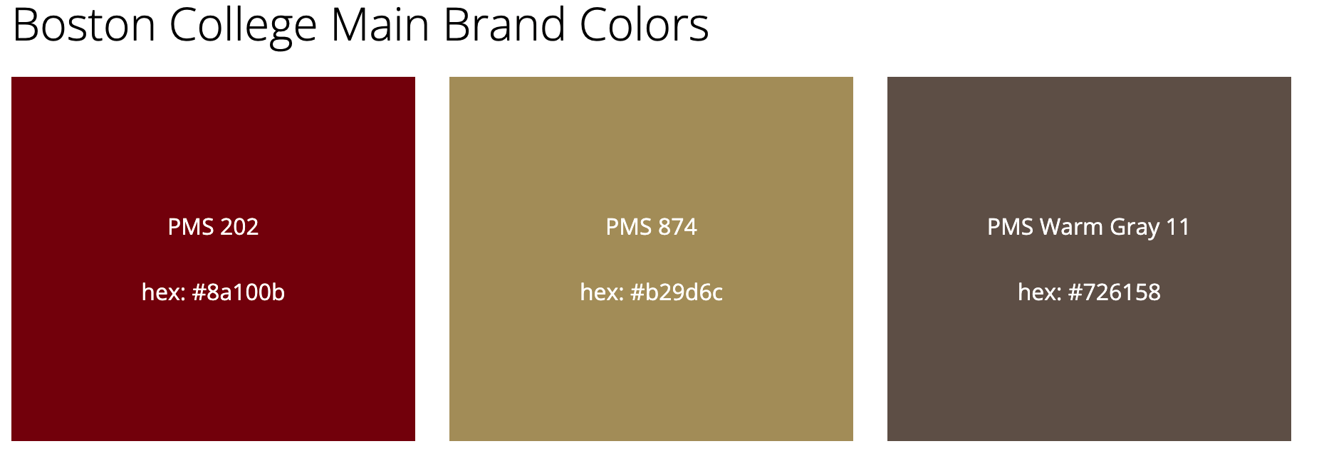
bc.edu/woods

